Slide 1
Strategic Plan for Diversity, Equity, & Inclusion
Academic Affairs | 2021-2024

Slide 2
Agenda
01
02
03
Why Academic Affairs Needs a DE&I Strategic Plan
How the DE&I Strategic Plan was Created
Acknowledgement & Purpose Statements
04
05
06
Goal 1:
Leadership &
Accountability
Goal 2: Faculty, Staff Development
Goal 3:
Student Learning
Experience

Slide 3
Why Academic Affairs Needs a DE&I Strategic Plan
01

Slide 4
Confluent Factors of Academic Affairs’ DE&I Strategic Plan
DE&I Strategic Plan
National Events
University Messaging
Provost’s Scholarship & Practice
Bentley Open Discussions
Social Media Feedback
Faculty Senate Discussions
Inequity in Higher Education

Slide 5
Behind the Factors of Academic Affairs’ DE&I Strategic Plan
DE&I Strategic Plan
Higher Education grapples with the pandemic and racial injustice movement sparked by George Floyd’s death.
Many Universities, including Bentley, are criticized for their “toothless” responses to George Floyd’s Death
Bentley’s first Latina Provost with 30+ years of practice in DE&I
Bentley students, faculty and alumni share about their lived experiences on campus.
On the @BlackAtBentley Instagram account, 56% of the posts are about troubling classroom or faculty interactions.
In the past year, DE&I topics were on the agenda for 8 of 14 Faculty Senate meetings
In 2017, only 24% of U.S. postsecondary faculty members were non-white.

Slide 6
How the DE&I Strategic Plan Was Created
02

Slide 7
Summary of DE&I Strategic Planning ​Process
Developed a Strategic Planning Framework
Reviewed Framework with Academic Affairs Leadership
Reviewed departmental practices shared at Faculty Senate
Reviewed and received input during Provost Open Office Hour and Provost’s Council
Engaged Academic Leadership in a DE&I full-day retreat
Reviewed with University’s Chief Diversity and Inclusion Officer​
Reviewed and received input from Faculty Senate
Review and receive feedback from students

Slide 8
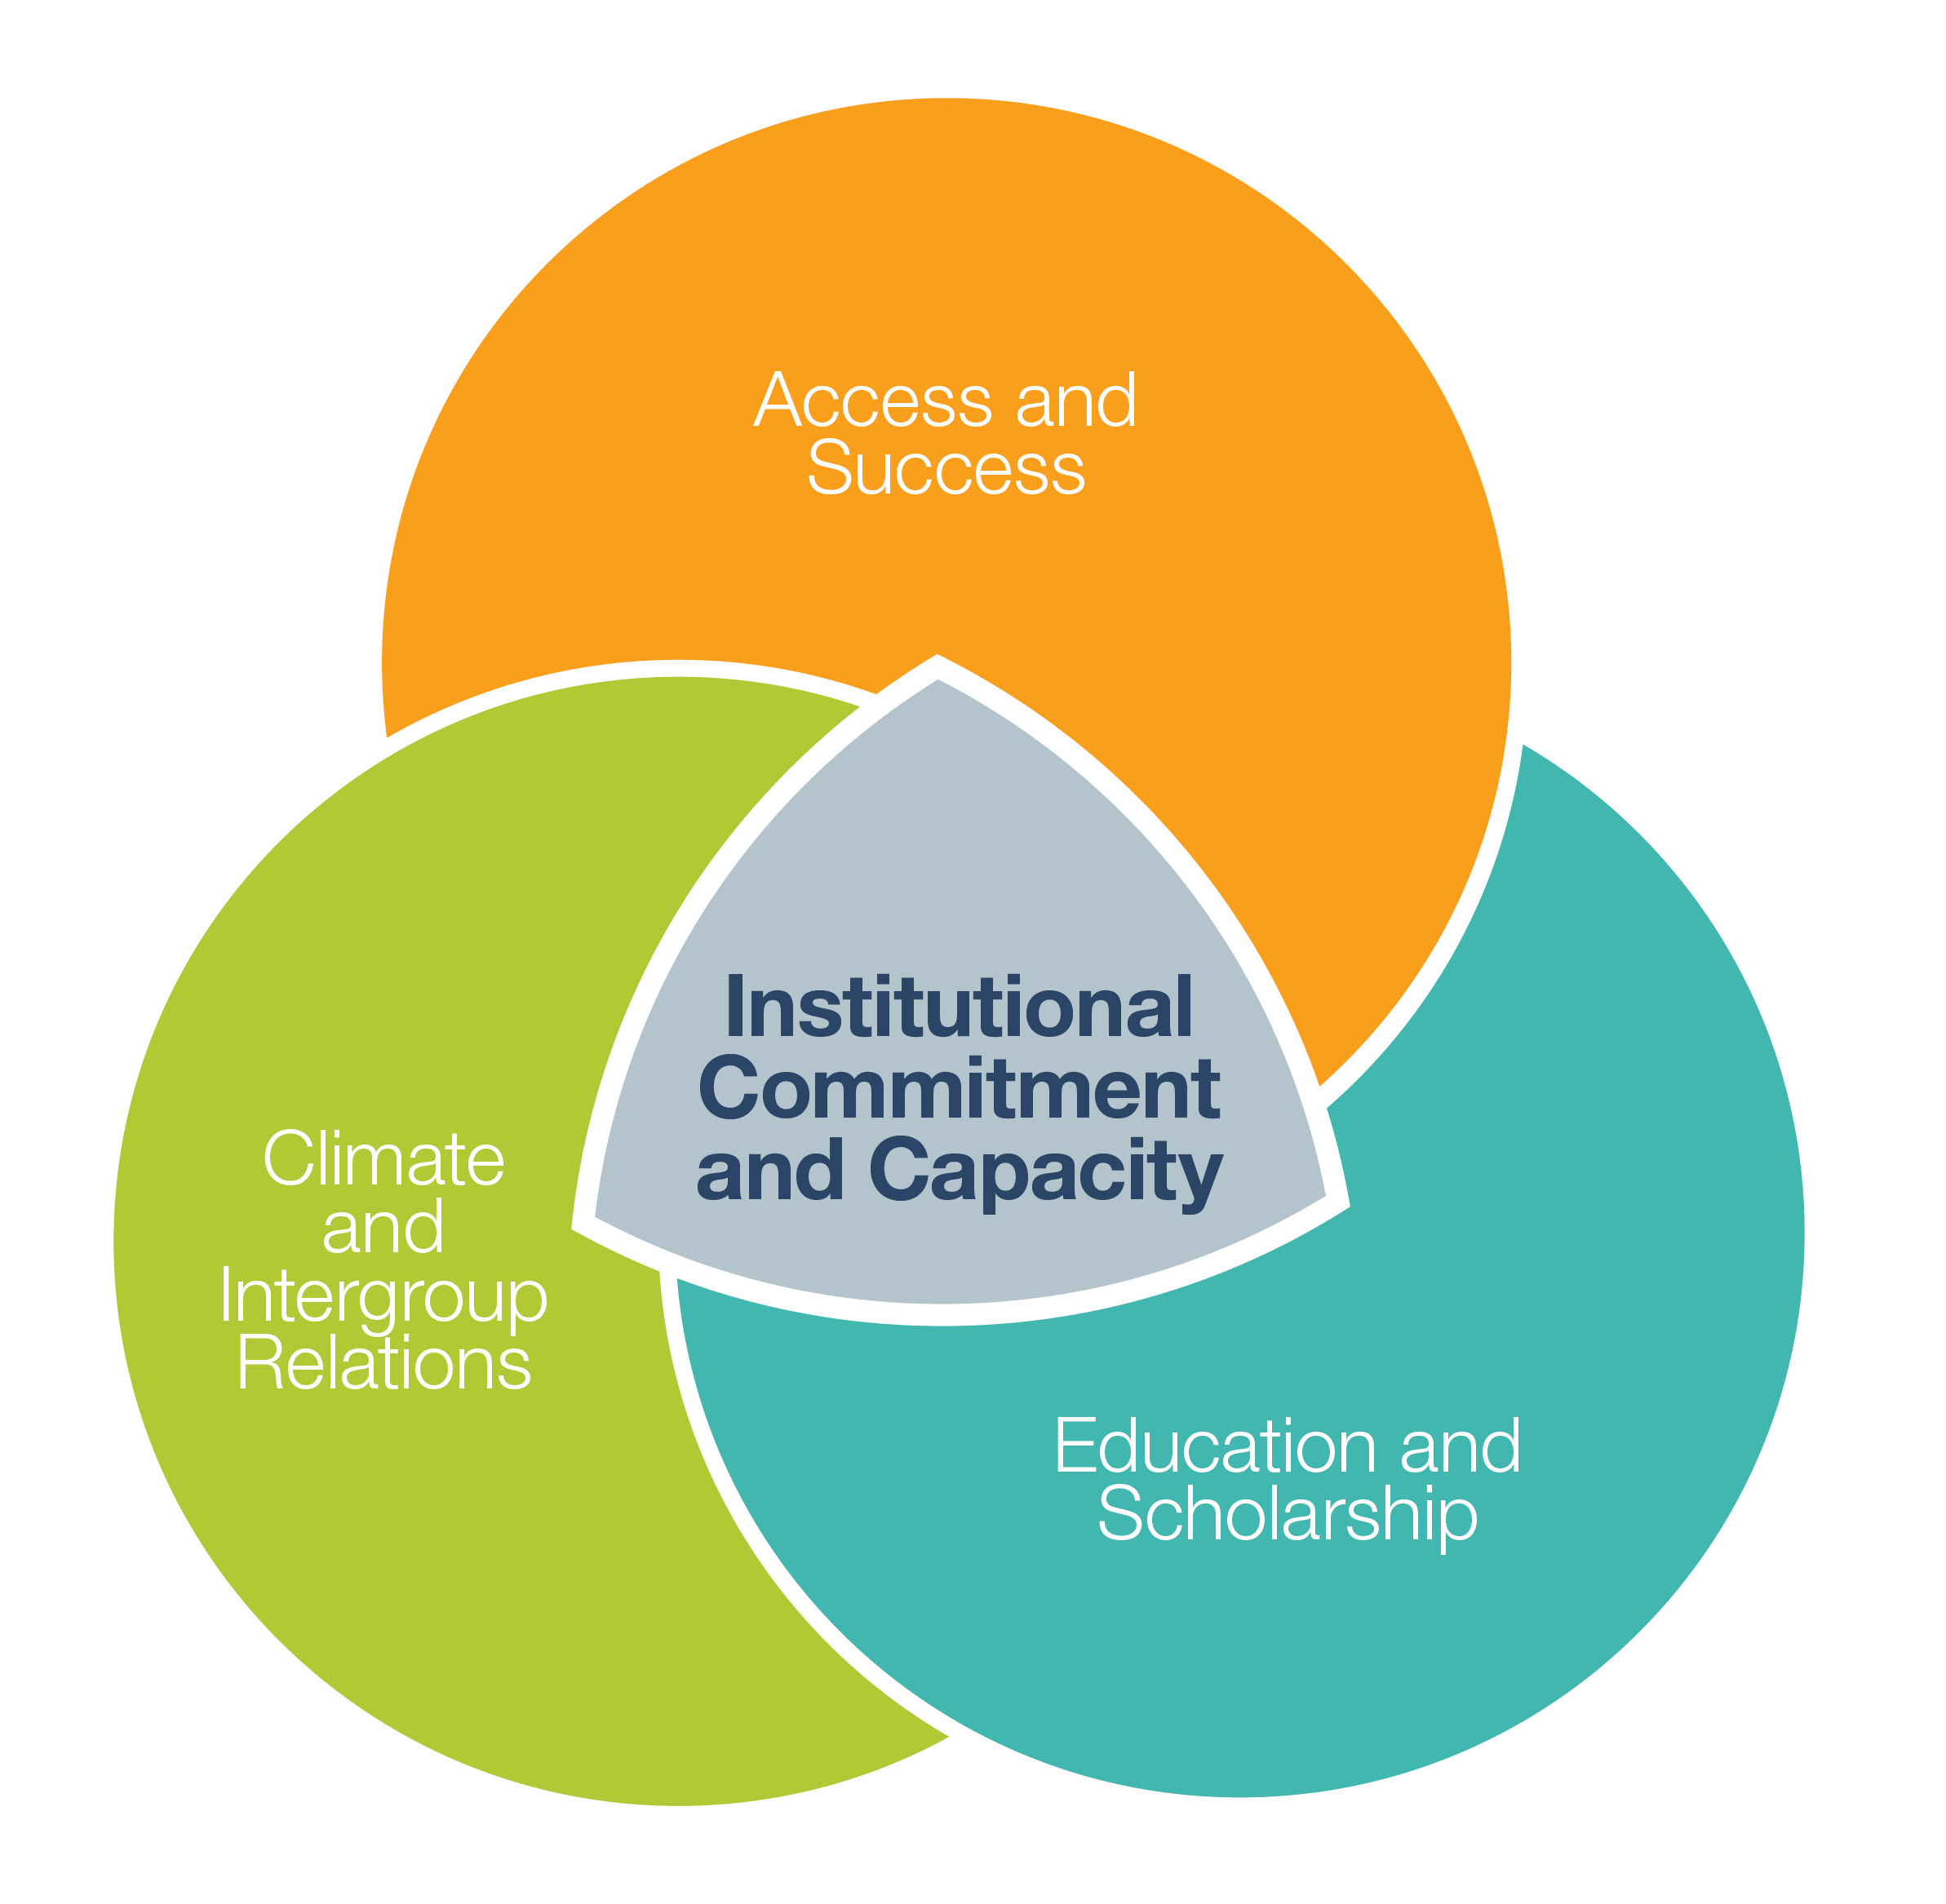
Inclusive
Excellence
This model, which also guides the work of the Office of Diversity and Inclusion, helped the planning team establish goals and priorities that address systemic and structural changes.

Slide 9
Inclusive Excellence Framework
Access and Success: The University supports efforts to increase the compositional number and success rates of historically underrepresented students, faculty, and staff members.
Climate and Intergroup Relationships: The University has developed a psychological and behavioral climate supportive of all community members AND works to develop capacity for enhanced quantity and quality of interactions across differences.
Education and Scholarship*: Diversity is embedded into the educational (curriculum, pedagogy, and co-curricular activities) and academic (research and scholarship) engagement on campus.
Institutional Capacity and Commitment: A commitment to diversity is embedded in institutional practices AND attention is paid to developing capacity of all members of the community to be effective in a diverse environment.
*Given the breadth of this frame, we separate out "Curriculum" and "Research" as two distinct frames. ​

Slide 10
Evaluating the Inclusive Excellence Framework
At the Provost Open Hour and Provost Council, the previous framework categories were reviewed thought the lenses of:
Data
Bentley Best Practices
Resources
Opportunities

Slide 11
Determining Strategic Priorities
At the full-day DE&I Retreat, Academic Leadership had to address these questions to add a strategic priority to the plan:
Why is this important to the AA DE&I strategy? ​
What is the timeframe to accomplish this priority? ​
Who is responsible? Why this person? ​
What are the success/measurable milestones? ​
What are the essential systems/structures needed to ensure this is successful?

Slide 12
Bentley’s Core Values
DIVERSITY: We are all different and that makes our community stronger. We embrace and seek to understand those with different beliefs, backgrounds and life experiences. We celebrate those differences as opportunities to learn and grow. We protect and affirm the right of all people to be themselves.
CARING: We practice understanding, compassion and kindness. We recognize the whole person and their well-being, and we think beyond ourselves and our immediate goals to consider the impact our actions have on other people.
HONESTY: We act with honesty and integrity in our academic, personal and professional affairs. We are dedicated to ethical and transparent behavior, and we hold ourselves accountable for our words and actions.
RESPECT: We treat others as they would like to be treated. We recognize the inherent dignity and worth of all members of our community and strive to better understand and appreciate everyone. We are committed to keeping our community free of vandalism, hate speech, violence and harassment.
The DE&I strategic plan aligns with the University's mission and values. The four values listed on the right were central to the creation of the plan.

Slide 13
Conceptual Hierarchy of the DE&I Plan
Purpose Statement
Goal 1:
Leadership &
Accountability
Goal 2:
Faculty & Staff
Hiring and Development
Goal 3:
Student Learning Experience
6
9
6
Strategic Priorities
Strategic Priorities
Strategic Priorities
Acknowledgements

Slide 14
Acknowledgement and Purpose Statements
03

Slide 15
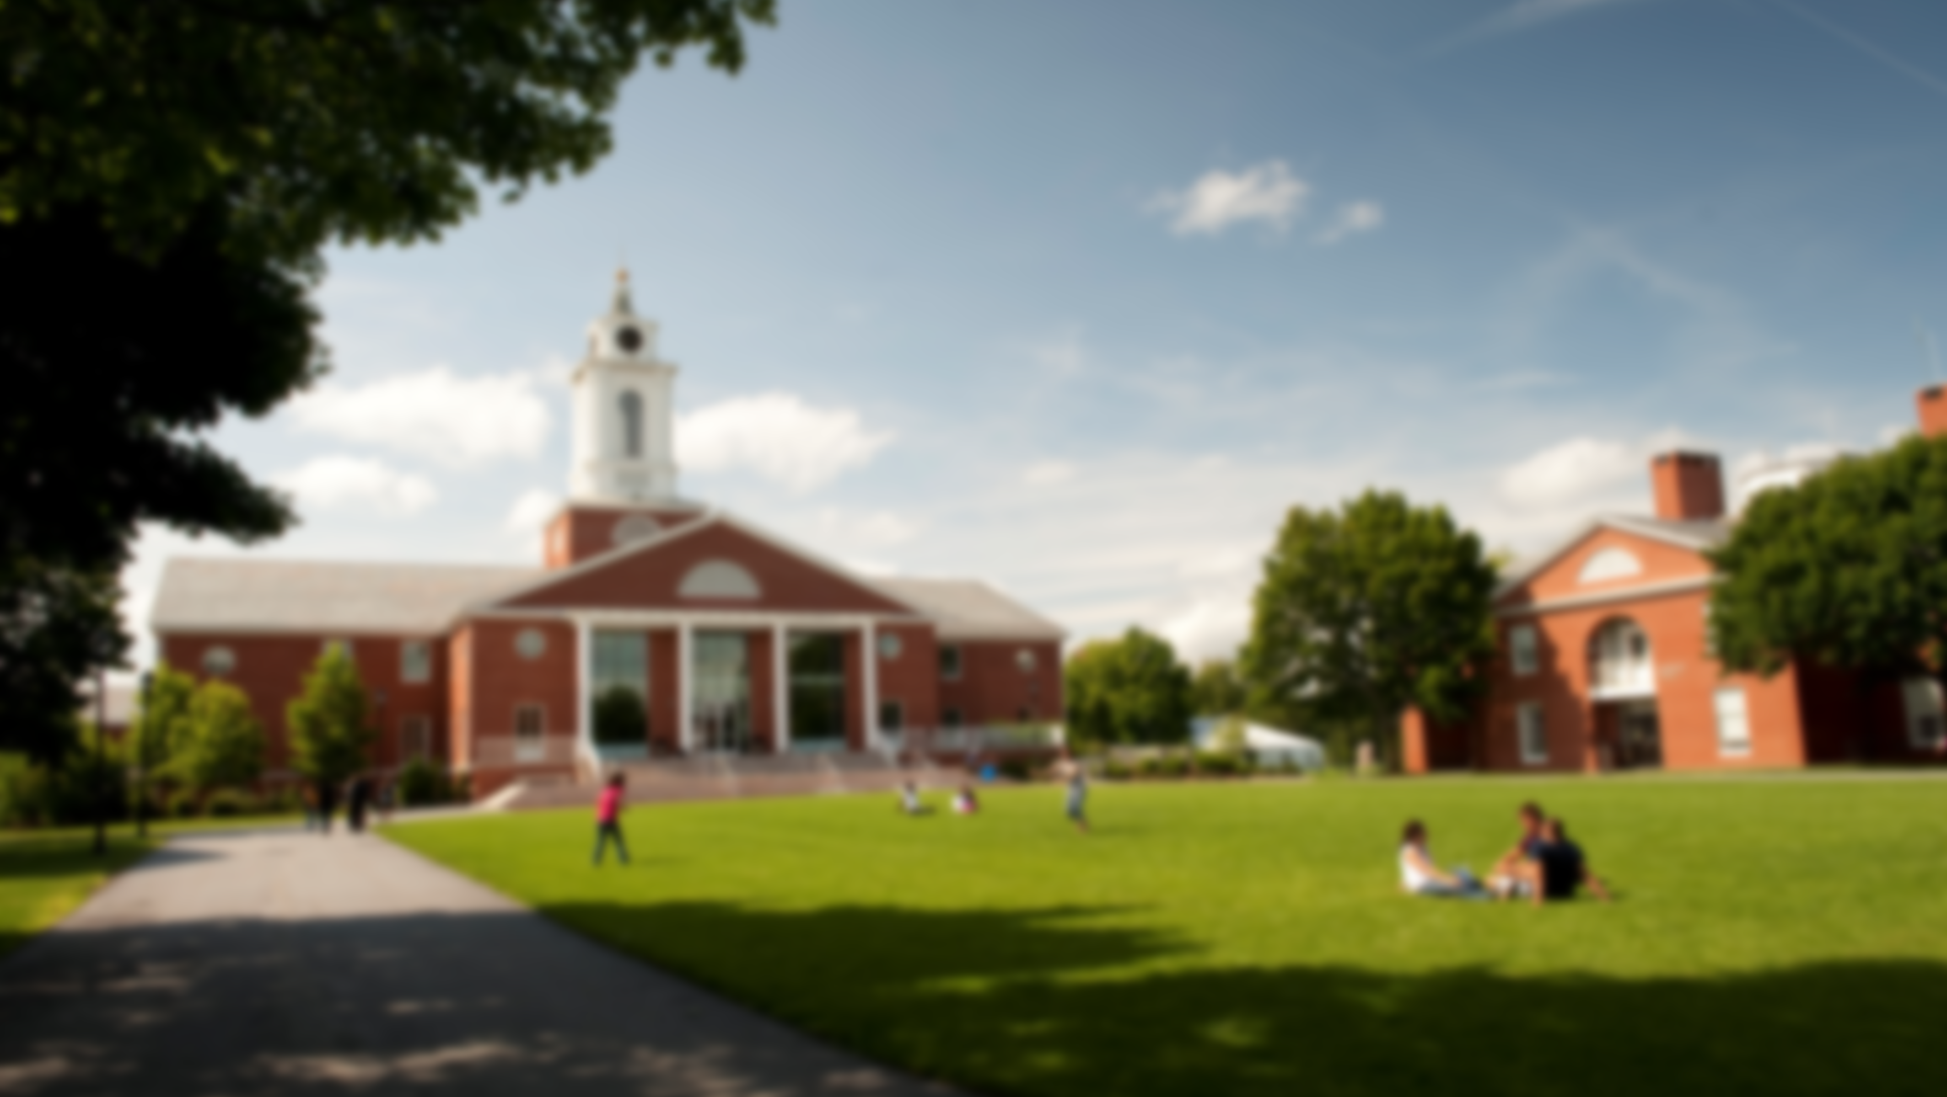
“
As we spoke with faculty, staff, and students to develop this strategic plan, we were humbled to hear an array of stories and lived experiences among the members of our community. We want to acknowledge that Bentley, like so many institutions of higher education, has a history of perpetuating privilege and supremacy. Over time, we have continued policies, practices, and decisions that have negatively impacted marginalized groups, and the unintended consequences of those actions have had ripple effects that shape the climate and culture that we see on campus today. As we move forward, we strive to identify equity gaps at Bentley, investigate the factors that maintain those inequities, and take action to eliminate them.
Higher education as an industry is not perfect, and Bentley has the potential to be a leader in the diversity, equity, and inclusion (DE&I) space. This plan is a sustained commitment to improving our institution, and to fostering a campus where all members of the Bentley community feel a sense of belonging.”
Acknowledgement Statement, DE&I Strategic Plan

Slide 16
“
We believe in the potential of all Bentley faculty, staff, and students to become more inclusive and caring individuals. Our most impactful learning occurs when we demonstrate courage to acknowledge when we do not know something and maintain curiosity to deepen our understanding. We commit to providing an environment of trust, inclusion, and engagement for students, staff and faculty to cultivate our individual and institutional growth.”
Purpose Statement, DE&I Strategic Plan

Slide 17
Goal 1: Leadership & Accountability
04

Slide 18
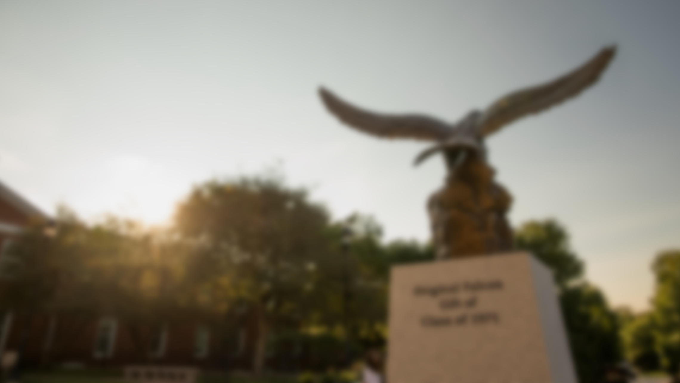
“
We seek to position Bentley’s academic leadership team (e.g., Provost, Associate Provosts, Deans, Associate Deans, Departments Chairs, Directors) as an exemplar for other institutions of higher education through structured positions, robust data and analytics, and established partnerships.”
Goal 1, DE&I Strategic Plan

Slide 19
Goal 1: Leadership and Accountability
Fall 2021 | Spring 2022 | Fall 2022 | Spring 2023 | Fall 2023 | Spring 2024
Recruit Assoc Dean for DE&I Provost, Deans, CDIO
Identify Trustee Professor Provost, Deans
Build University-wide Dashboard and Increase Reported Metrics Academic Leadership, Business Intelligence, CDIO
 | Faculty Diversity Council Associate Dean for DE&I, Faculty Senate
 |  | Departmental Audit on DE&I Efforts Associate Dean of DE&I, Department Chairs
 |  | Establish a DE&I Thought Leadership Network Associate Provost for Research and Faculty, Trustee Professor of DE&I, Faculty
Current Progress

Slide 20
Goal 2: Faculty & Staff Hiring and Development
05

Slide 21
“
We strive to increase our use of best practices for recruiting, supporting, and retaining faculty with expertise in areas of diversity, equity, and inclusion (DE&I). We will engage faculty and staff in innovative development opportunities that allow for ongoing education related to DE&I topics.”
Goal 2, DE&I Strategic Plan

Slide 22
Goal 2: Faculty & Staff Hiring and Development
Fall 2021 | Spring 2022 | Fall 2022 | Spring 2023 | Fall 2023 | Spring 2024
Implicit Bias Training for Search Committees Associate Dean of DE&I, CDIO, HR, Dept Chairs
Require Candidate Diversity Statements Assoc Provost Research & Facility, Deans, Dept Chairs, et al.
Expand External Opportunities for Faculty Provost, Assoc Dean of Assurance Learning & Accreditation
Faculty Cluster Hiring Associate Dean of DE&I, Dean of Business, Dean of Arts & Sciences, Department Chairs
Annual Inclusive Pedagogy Training and Development Provost, Dean of Arts & Sciences, Dean of Business, Associate Dean of Assurance of Learning & Accreditation
Ensure Equitable Faculty Hiring Practices Dean of Arts and Sciences, Dean of Business, Associate Dean of DE&I, Department Chairs
 | PhD Project and SREB groups (Southern Regional Educational Board) Associate Dean of DE&I, Faculty
 |  | Recognize and Reward DE&I Efforts Assoc Deans, Department Chairs, Managers, HR, et al.
 |  | Research Mentorship for New Faculty of Color Assoc Provost for Research and Faculty, Faculty
Current Progress

Slide 23
Goal 3: Student Learning Experience
06

Slide 24
“
We commit to providing learning experiences and environments in which all students can succeed. We seek to offer programs, events, and resources that will equip students with the core competencies to navigate and address issues of diversity, equity, and inclusion.”
Goal 3, DE&I Strategic Plan

Slide 25
Goal 3: Student Learning Experience
Fall 2021 | Spring 2022 | Fall 2022 | Spring 2023 | Fall 2023 | Spring 2024
FirstGen Presidential Fellows Associate Dean of Arts & Science
Pathway to Honors and Advanced Standing Programs Dean of A&S, Sr. Assoc. Dean for Grad Programs
Support DE&I in the Curriculum Faculty, Academic Leadership, Badavas Center, et al.
Collaborations with Campus Partners to Enhance Support of Students Academic Leadership, Faculty
 |  | Advance Fundraising Opportunities for Student Programs Provost, Dean of Arts and Sciences, Dean of Business
 |  | Expansion of Doctoral Programs for Unrepresented Students PhD Program Director, Senior Associate Dean for Graduate Programs
 |  | Mutually Beneficial Partnerships with Minority-serving Institutions Provost, Senior Academic Leadership, Director of the Office of International Education
Current Progress

Slide 26
Comments or Questions?
Please reach out to our team, if you have any feedback.
Office of the Provost​
781.891.2357
OfficeOfTheProvost@bentley.edu​

